Slide 1


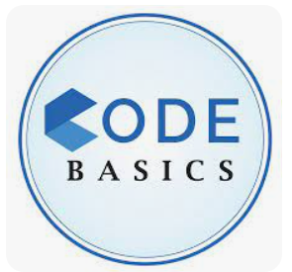
Consumer Goods Ad_Hoc Insights
Provide Insights to Management in Consumer Goods Domain
Presented by – SHARANAGOUDA BIRADAR

Slide 2
Content
About Company
Company Market & Data
Ad-hoc Request, Query & Output
Visualization & Insights

Slide 3
ATLIQ HARDWARE
Company Overview:
Atliq Hardware, a leading computer hardware producer in India.
Global presence with expansions in multiple countries.
Company Problem:
The management noticed that they do not get enough insights
To make quick and smart data-informed decisions.

Slide 4
Company Decision/Challenge:
Tony Sharma, their data analytics director wanted to hire someone
The person should be good at both tech and soft skills.
Decision to conduct an SQL challenge for holistic skill assessment.

Slide 5
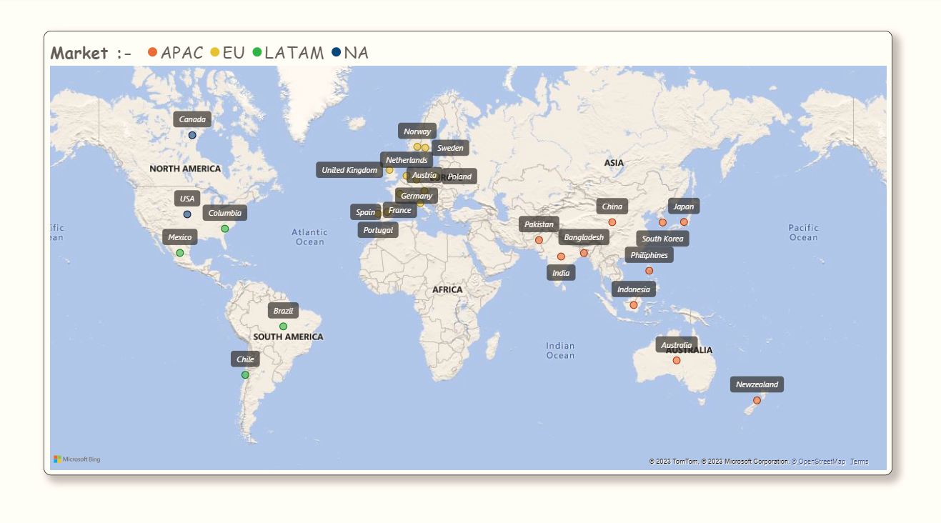
Atliq Market

Slide 6
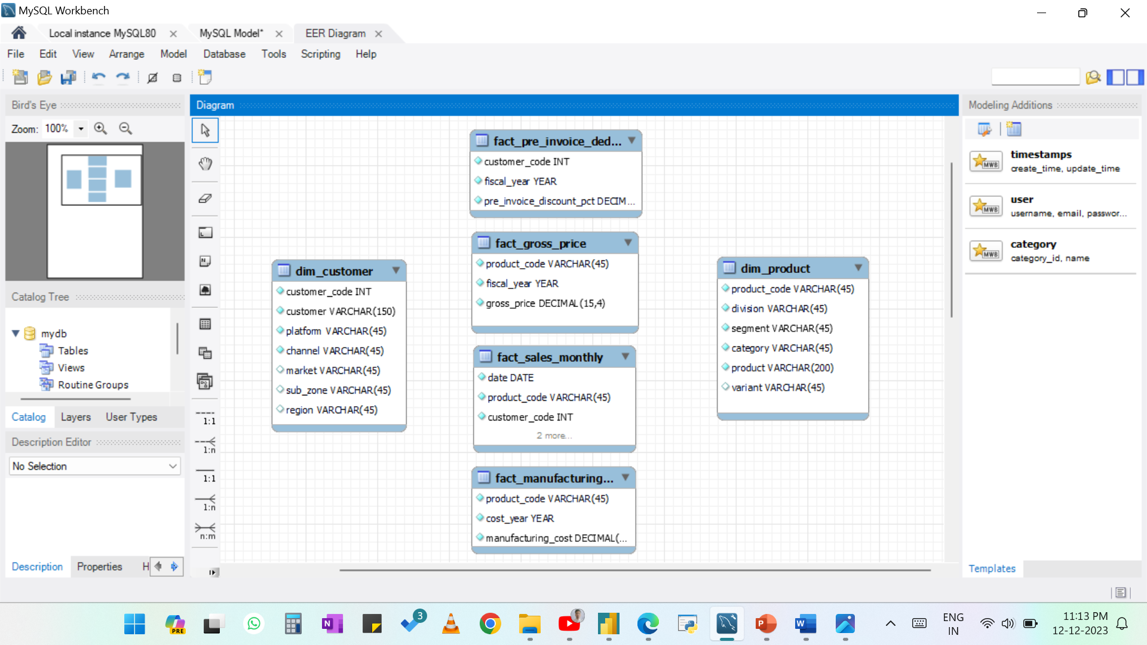

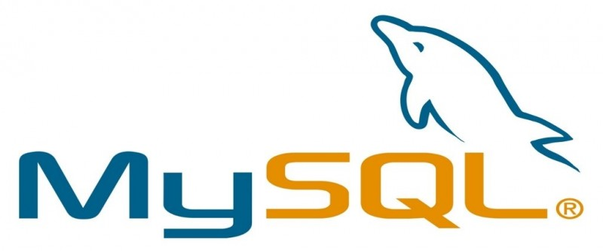

Input Data
Tools Used

Slide 7
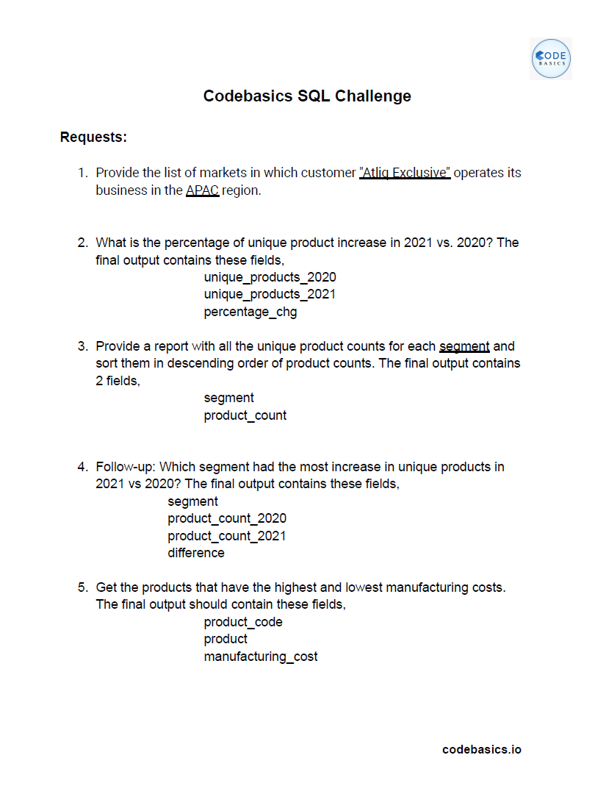
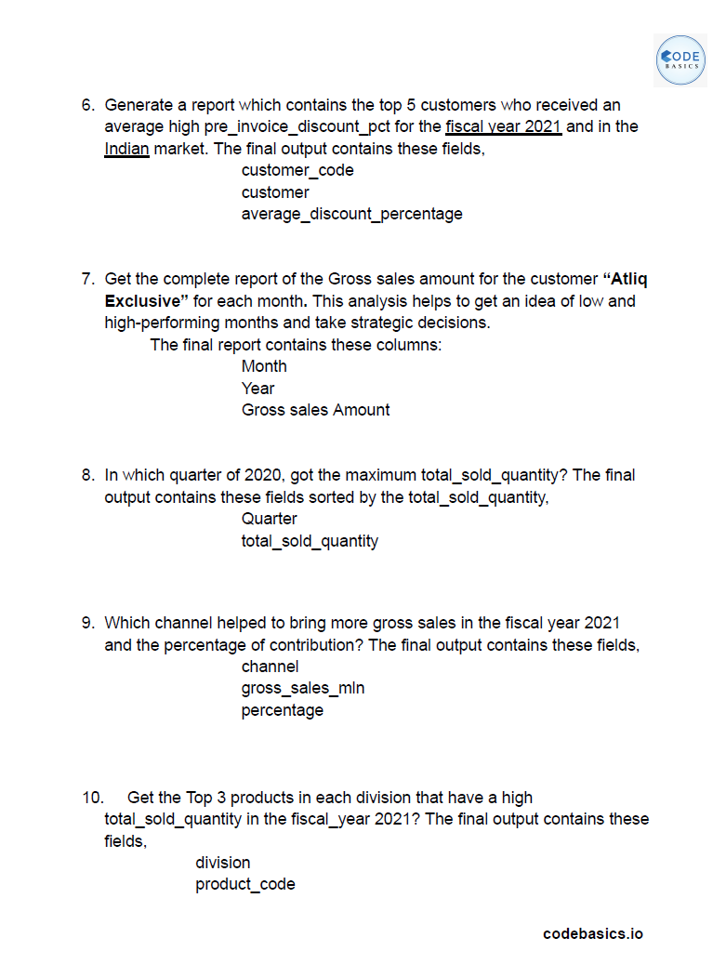
10 Ad Hoc - Requests

Slide 8
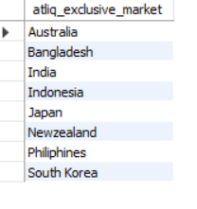
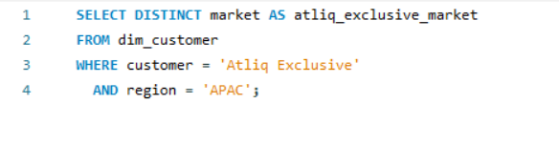
Request | Query | Output
1. Provide the list of markets in which customer "AtliQ Exclusive" operates its business in the APAC region
OUTPUT
QUERY

Slide 9
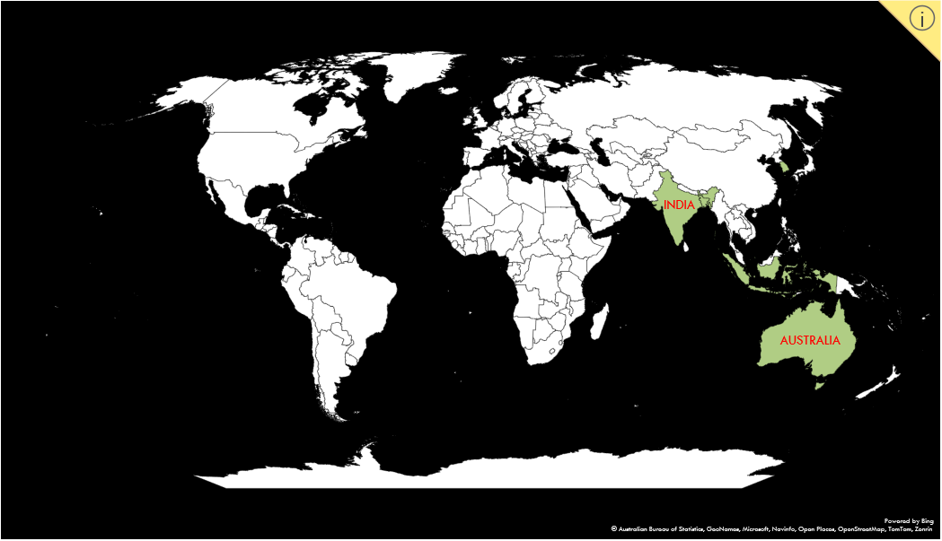
Atliq Market in APAC Region

Slide 10
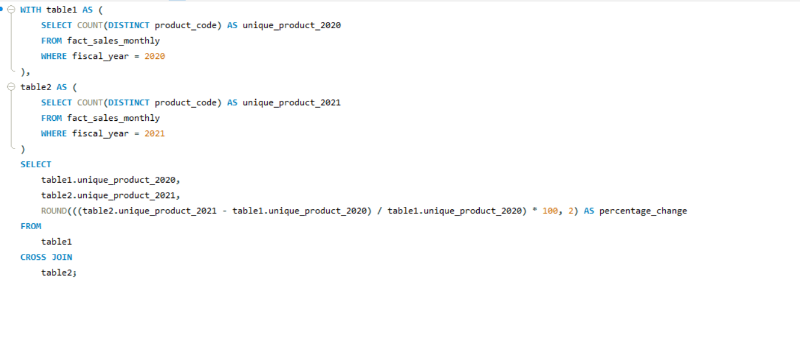
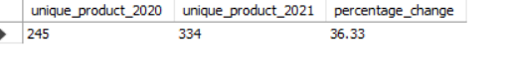
Request | Query | Output
2. What is the percentage of unique product increase in 2021 vs. 2020?
QUERY
OUTPUT

Slide 11
Visualization | Insights
The Product increase in 2021 is 36.33%.
Continuously Innovating with introducing new Product.

Slide 12
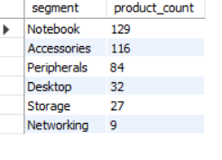
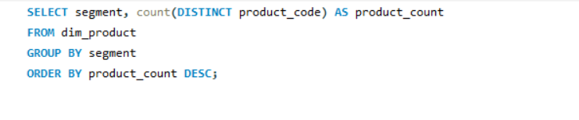
Request | Query | Output
3. Provide a report with all the unique product counts for each segment and sort them in descending order of product counts.
QUERY
OUTPUT

Slide 13
Visualization | Insights
Notebook, Accessories & Peripherals contribute around 83%
Some new product should be introduced in Networking.

Slide 14
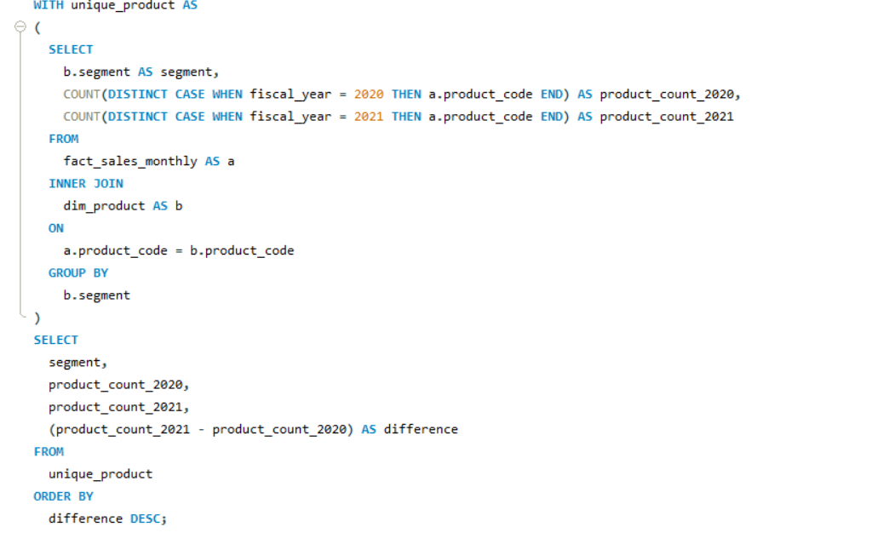
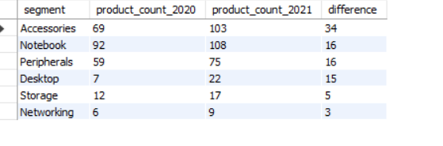
Request | Query | Output
4. Follow-up: Which segment had the most increase in unique products in 2021 vs 2020?
QUERY
OUTPUT

Slide 15
Visualization | Insights
Accessories has 34 the largest increase in production
Storage and Networking producing lowest

Slide 16
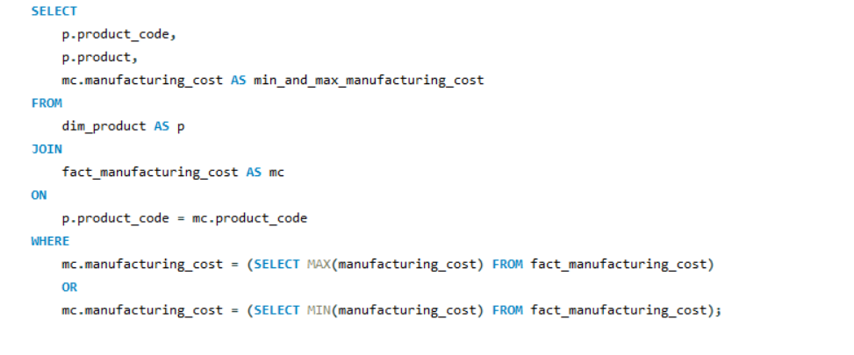
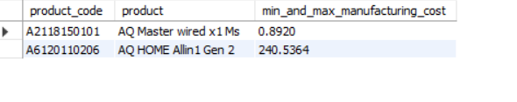
Request | Query | Output
5. Get the products that have the highest and lowest manufacturing costs.
QUERY
OUTPUT

Slide 17
Visualization | Insights
The product that have highest manufacturing cost is AQ Home Alln1 Gen 2 is 240.5364
The product that have lowest manufacturing cost is AQ Mater wired *1 MS is 0.8920

Slide 18
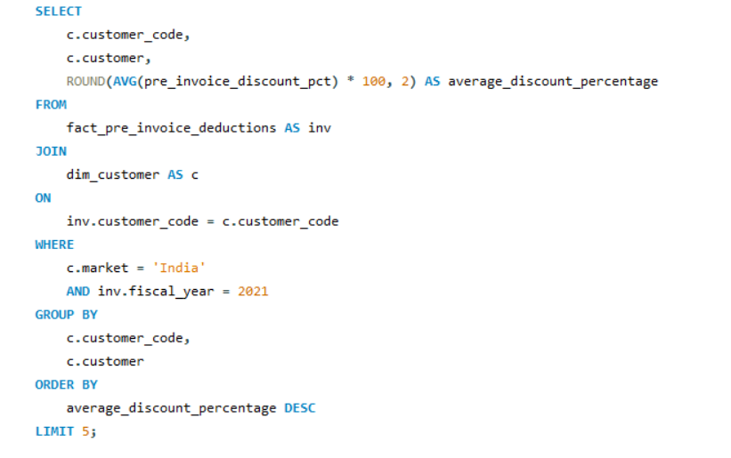
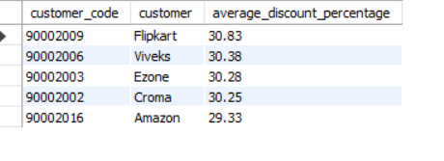
Request | Query | Output
6. Generate a report which contains the top 5 customers who received an average high pre_invoice_discount_pct for the fiscal year 2021 and in the Indian market.
QUERY
OUTPUT

Slide 19
Visualization | Insights
In 2021 the average pre invoice discount given by top 5 customer is similar however Flipkart gave the highest average discount that is 30.83 %

Slide 20
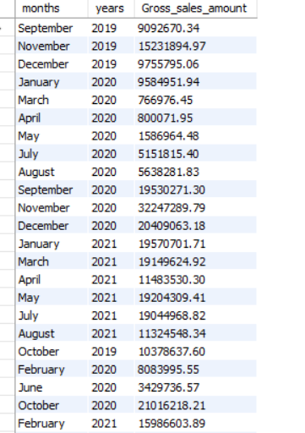
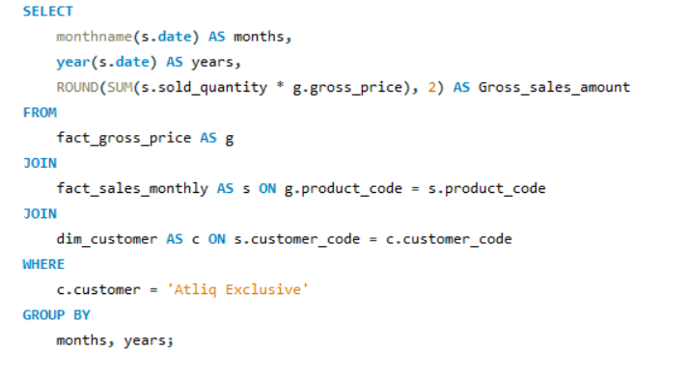
Request | Query | Output
7. Get the complete report of the Gross sales amount for the customer “Atliq Exclusive” for each month.
OUTPUT
QUERY

Slide 21


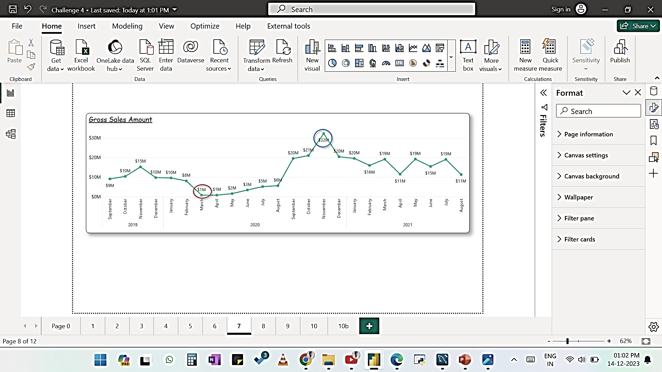
Visualization | Insights
Lowest Sales – March 2020 (Covid & Global Chip Shortage)
Highest Sales – November 2020 (Festive Season)

Slide 22
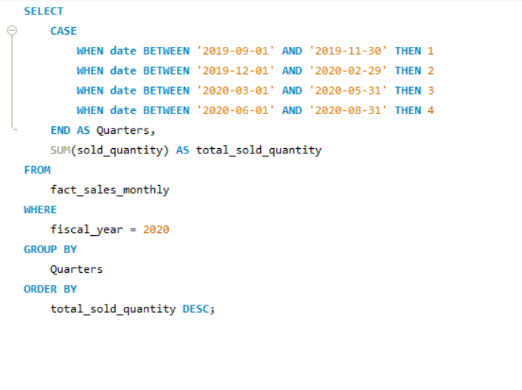
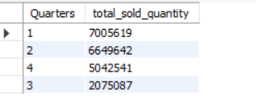
Request | Query | Output
8. In which quarter of 2020, got the maximum total_sold_quantity?
QUERY
OUTPUT

Slide 23
Visualization | Insights
In Quarter 1 sold maximum quantity that is 7 M whereas Quarter 3 significantly decreased to 2.1 M, the reason behind is the Covid-Lockdown in the month of March, April & May.

Slide 24
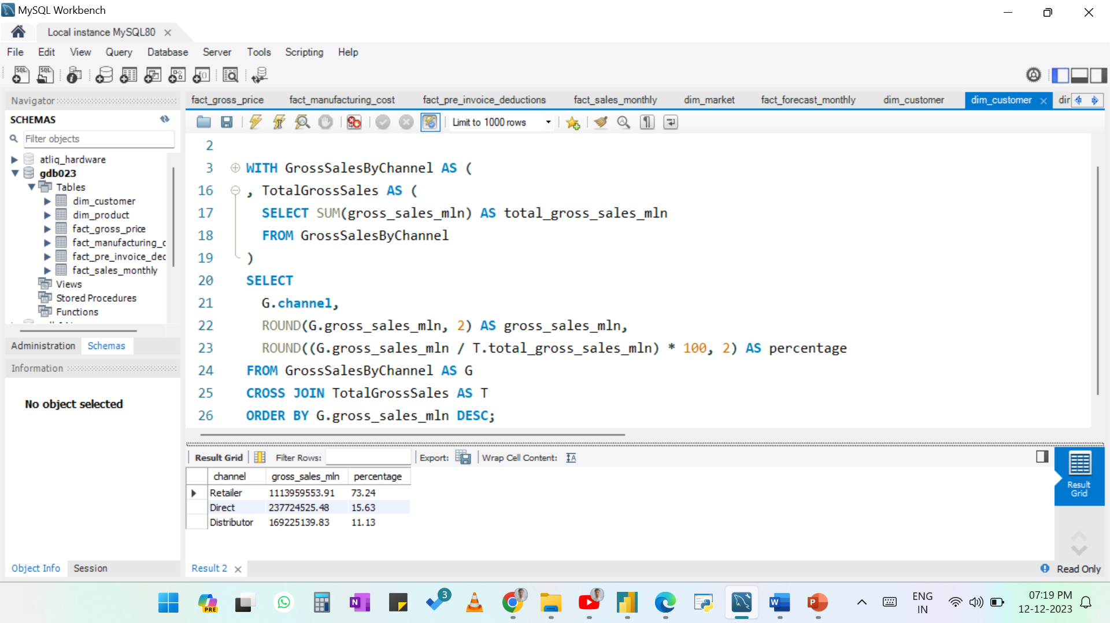
Request | Query | Output
9. Which channel helped to bring more gross sales in the fiscal year 2021and also find the percentage of contribution?
QUERY
OUTPUT

Slide 25
Visualization | Insights
The Retailers contribute to the major portion of the sales that is 73% whereas Direct and Distributer combined sales is 27%.

Slide 26
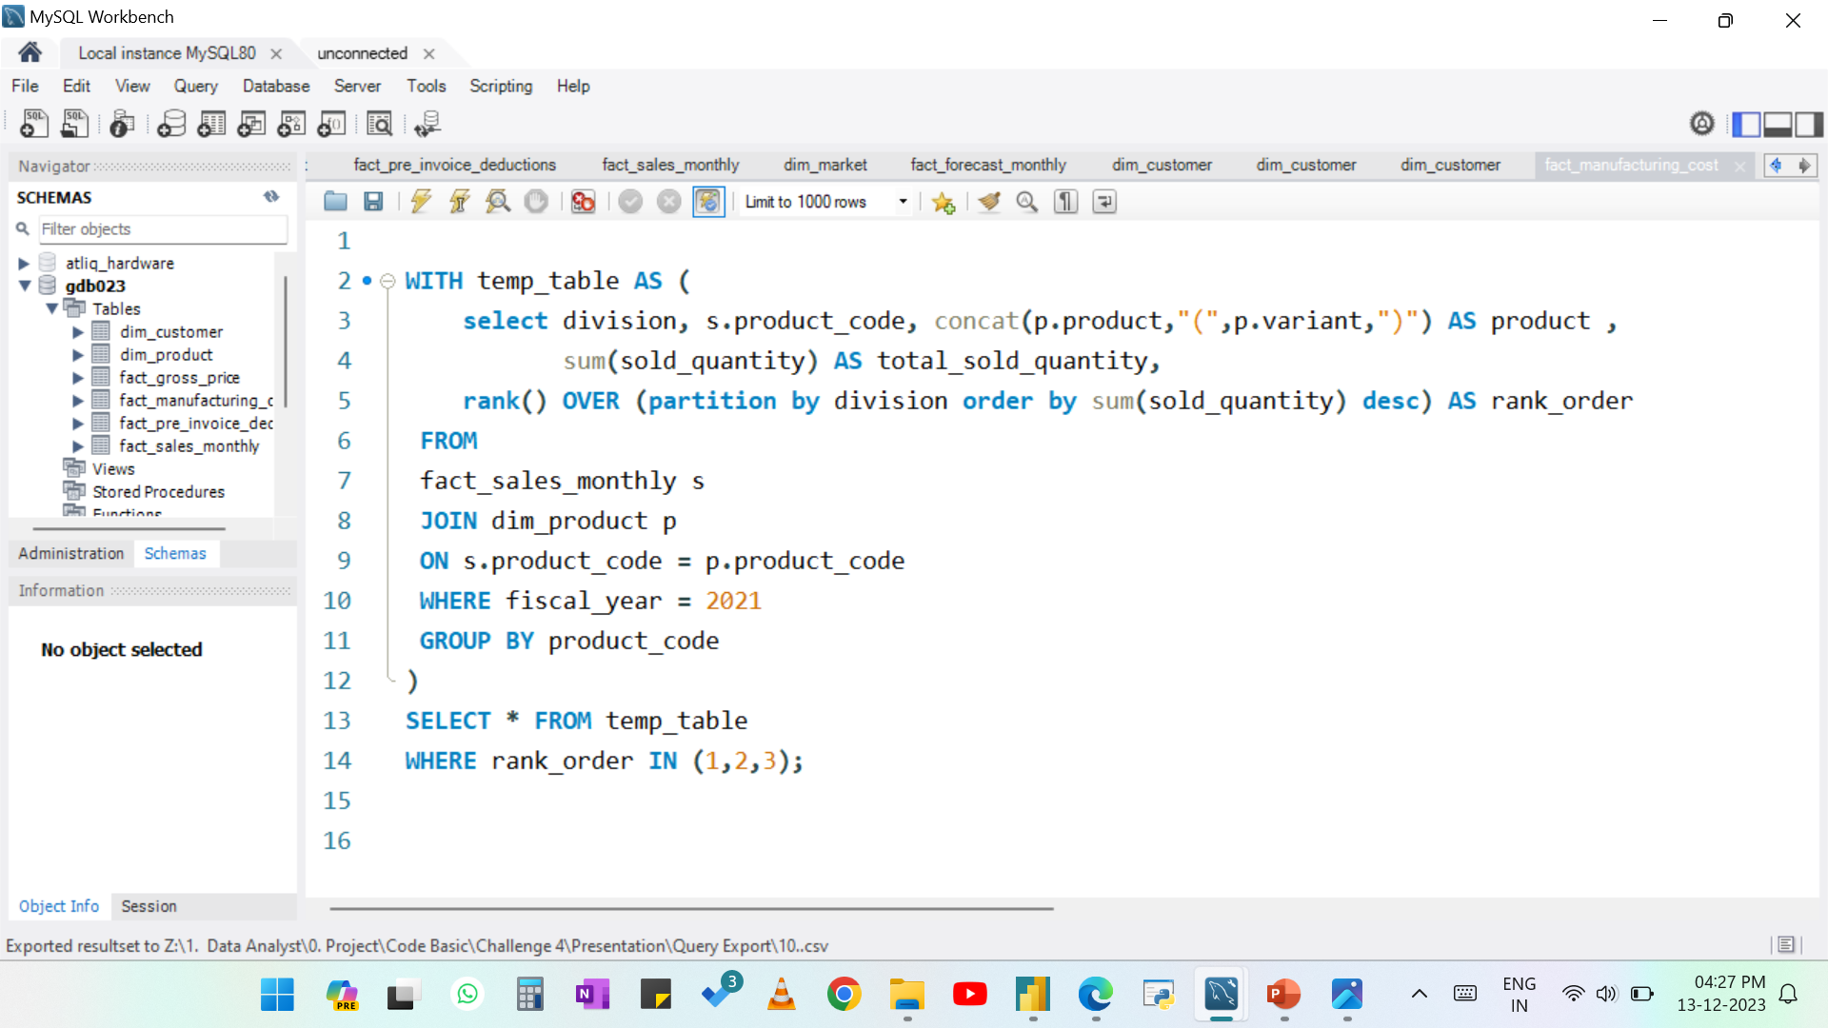
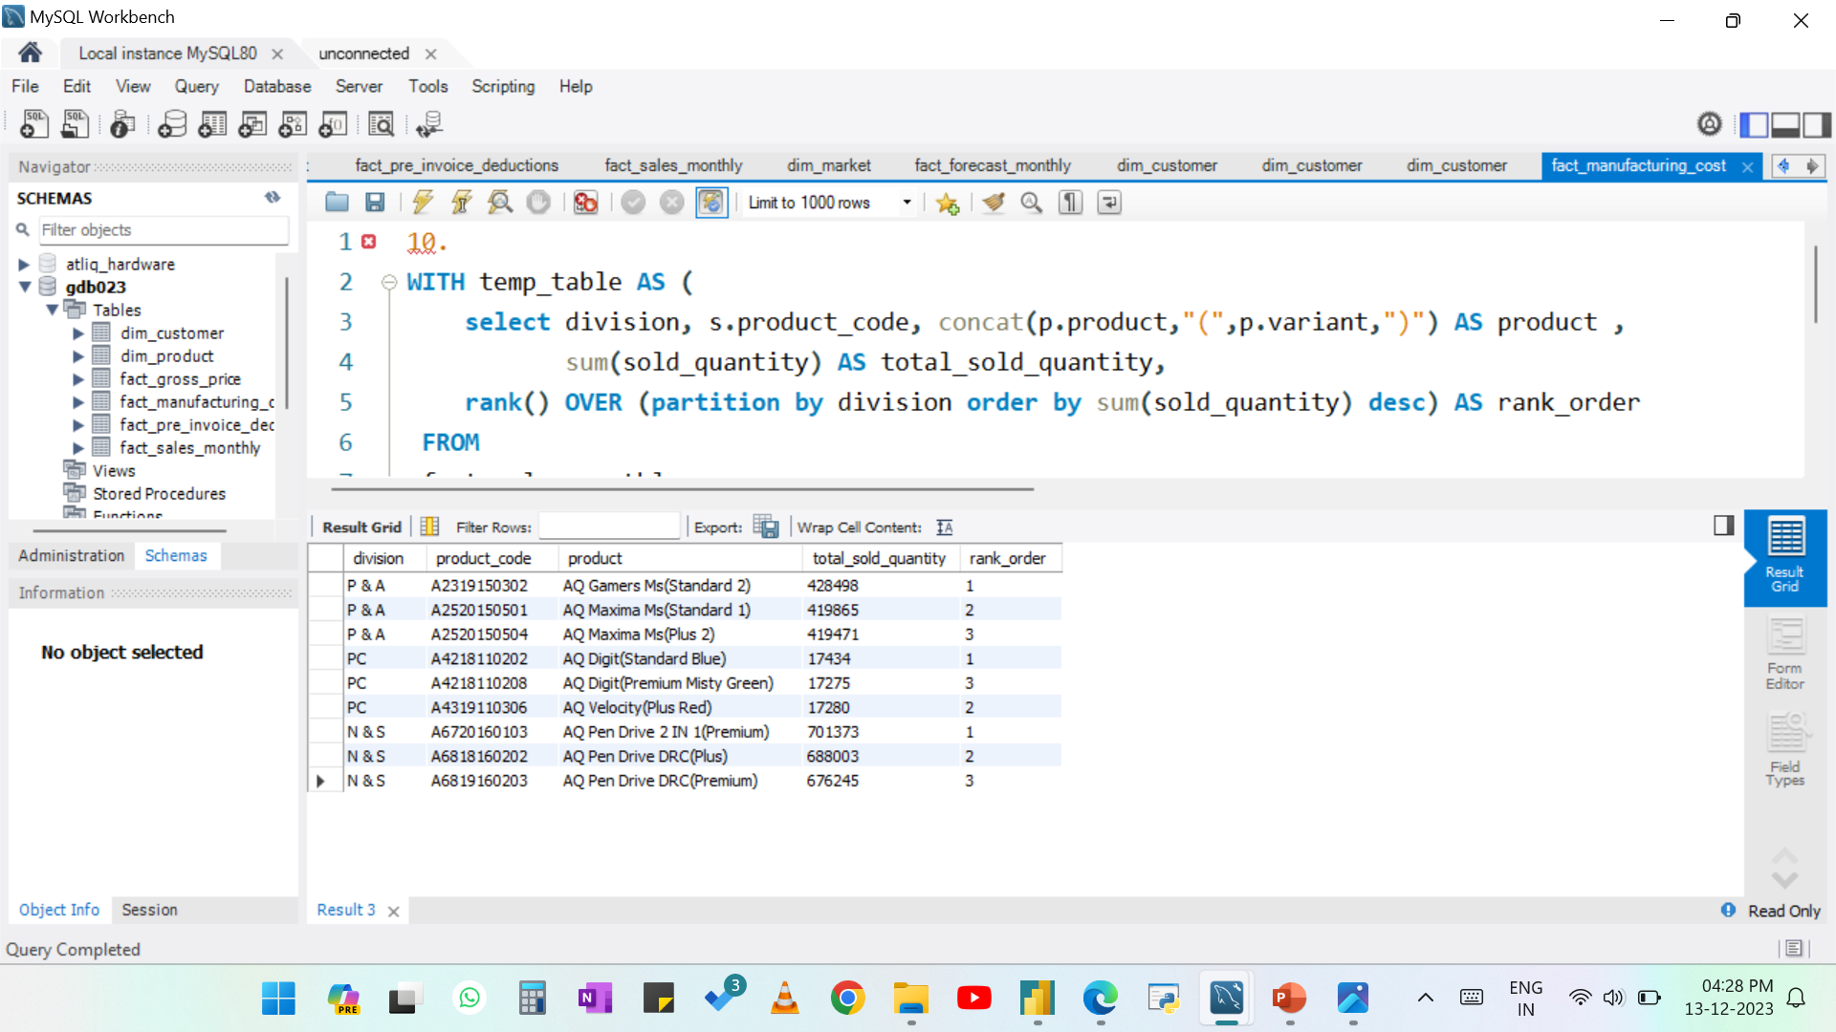
Request | Query | Output
10. Get the Top 3 products in each division that have a highest total_sold_quantity in the fiscal_year 2021?
QUERY
OUTPUT

Slide 27
Visualization | Insights
Top 3 products in each division that have a highest total sold quantity in the fiscal year 2021

Slide 28


